Slide 1
Garment Manufacturing Supply chain analysis Worker Productivity Factors Analysis
陳逸 Rachel Chen

Slide 2
Dataset
Dataset Description
This dataset provides information about garments workers' productivity across various teams, capturing metrics related to their performance, workload, and work environment.
Size: 1,198 rows / 15 columns
Source: https://www.kaggle.com/datasets/arnobsaharoy/garments-worker-productivity?select=garments_worker_productivity.csv

Slide 3
Breakdown of the Columns
date: The specific date of the record.
quarter: Divides each month into five parts, with each quarter roughly representing a week.
department: The department where the team operates (e.g., sewing, finishing).
day: The day of the week (e.g., Thursday).
team: Identifies the team number.
targeted_productivity: The target productivity rate set for the team.
smv (Standard Minute Value): The standard time required to produce a garment or unit of work.
wip (Work In Progress): The count of unfinished products currently being worked on.
over_time: The total overtime hours worked by the team.
incentive: Monetary incentives provided to the team.
idle_time: The duration (in minutes) when workers were not actively working.
idle_men: The count of workers idle during the recorded period.
no_of_style_change: The number of style or design changes implemented during production.
no_of_workers: The total number of workers in the team.
actual_productivity: The actual productivity rate achieved by the team, expressed as a ratio.

Slide 4
About
Purpose
The purpose of this report is to analyze and model the factors influencing productivity using statistical techniques and regression analysis.
Data Processing
Data Loading
Data Cleaning
Remove Unusable Columns
Log Transformation
Convert Data Types
Create New Column for Percentage Achievement
Data Mining
- Boxplot & T-test Analysis
Correlation Analysis
- OLS Regression Model for Prediction
Notes:
Log: The actual_productivity values likely range between 0 and 1 (as percentages). Taking the logarithm can help reduce skewness and make the distribution more symmetric, which is often a prerequisite for statistical analysis or modeling. 取對數有助於減少偏度 更加均勻分布 (看之前sca得作業說明可能會更懂:Therefore, when data is transformed into logarithmic scale, it tends to become more evenly distributed compared to its original scale.，power bi 圖片也有取對數，bar chart看起來會更均勻分布，減少異常值，極端值)

Slide 5
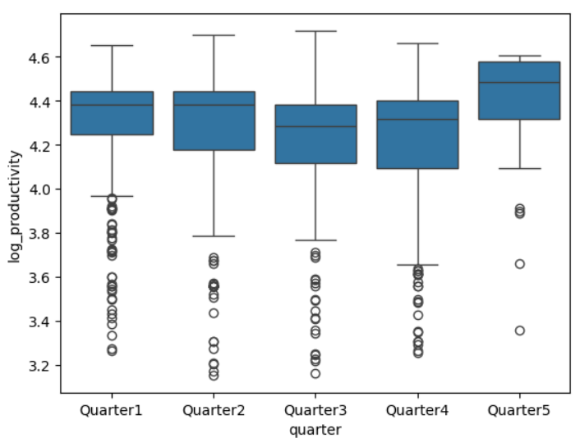
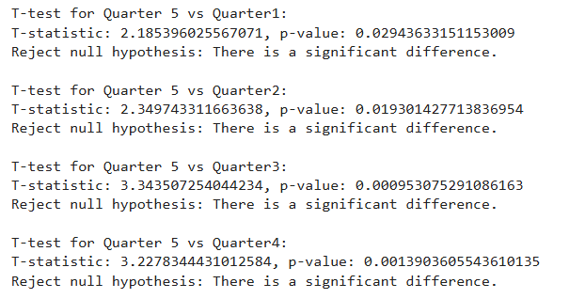
Boxplot and T-test Analysis Comparing Productivity by Quarter
Hypotheses:
Null Hypothesis (H0): No productivity difference between Quarter 5 and others.
Alternative Hypothesis (H1): Productivity differs between Quarter 5 and others.
At 95% confidence, p-values < 0.05 for all comparisons, rejecting H0.
Quarter 5 shows significantly higher productivity.

Slide 6
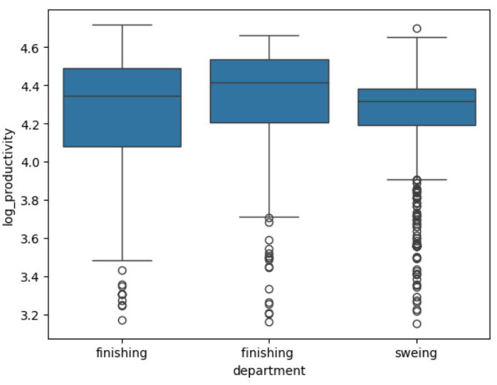
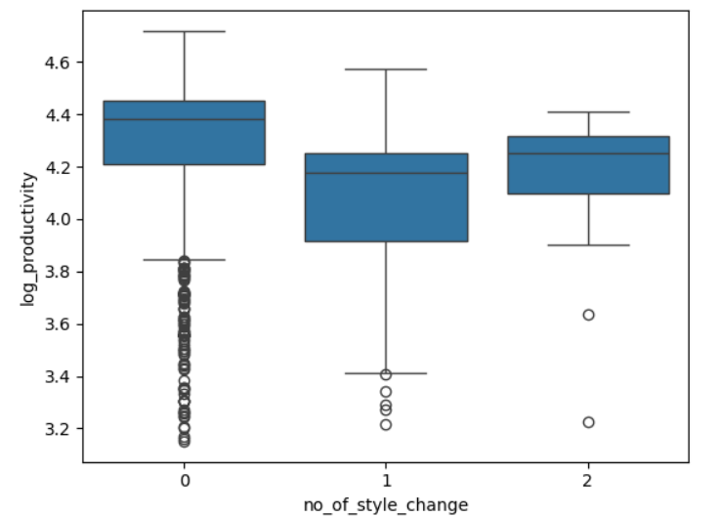
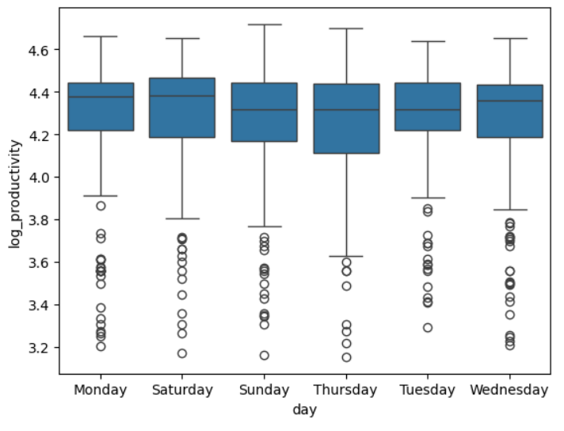
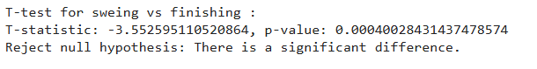
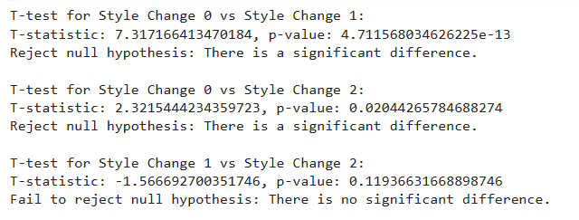
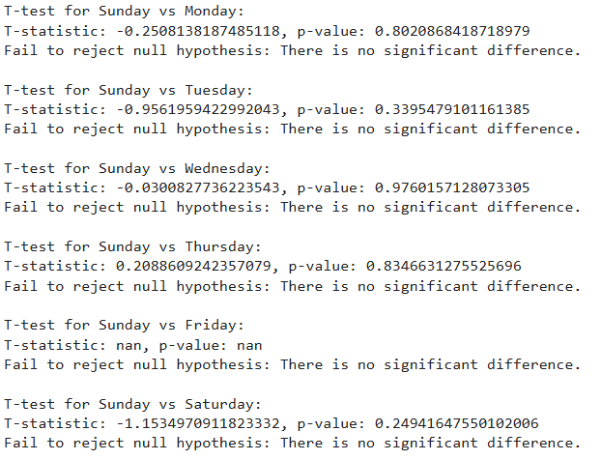
Boxplot and T-test Analysis Comparison of Productivity Data Across Departments, Days, and Number of Style Changes
Finishing outperforms Sewing in productivity.
Style changes lower productivity.
Weekdays vs. weekends show no productivity difference.

Slide 7
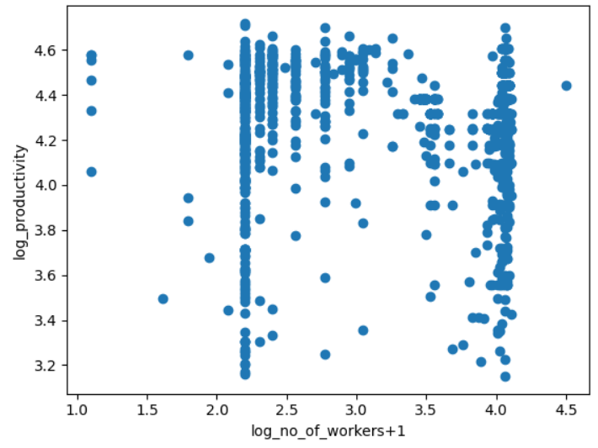
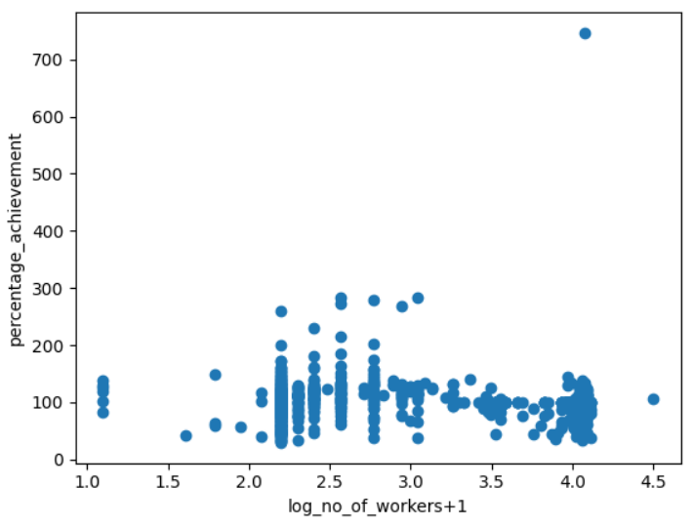
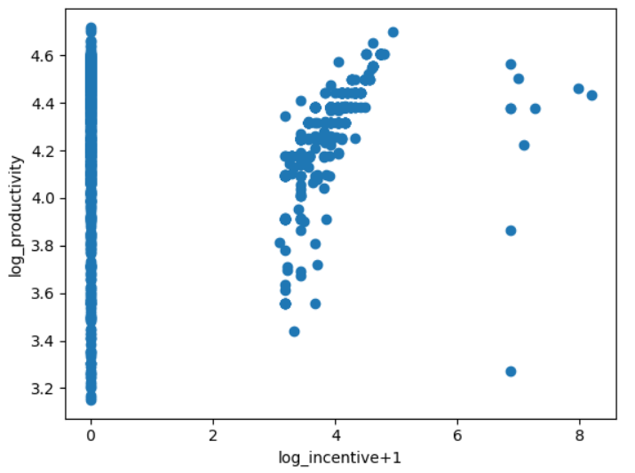
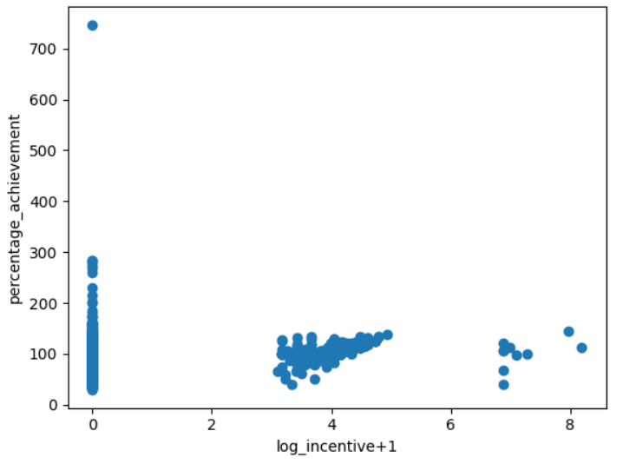
Correlation Analysis Productivity & Percentage Achievement
Productivity
Percentage Achievement
Team size has no significant correlation with productivity or achievement rate.
Incentives show a weak but positive correlation with productivity and achievement rate.
Number of Workers
Correlation Coefficient = -0.00286
Number of Workers
Correlation Coefficient= -0.00802
Incentive
Correlation Coefficient = 0.21706
Incentive
Correlation Coefficient = 0.13651

Slide 8
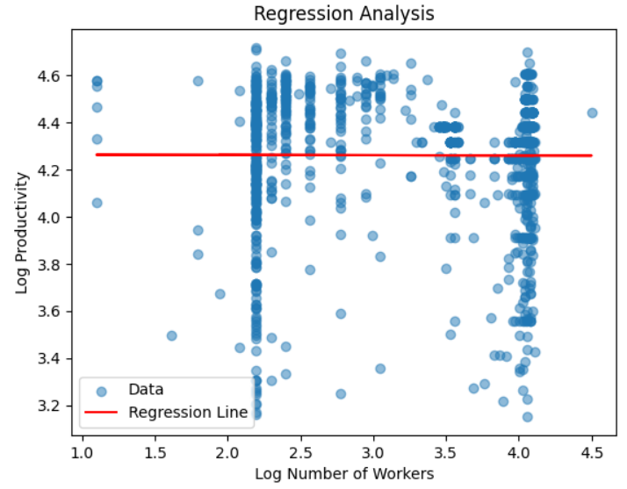
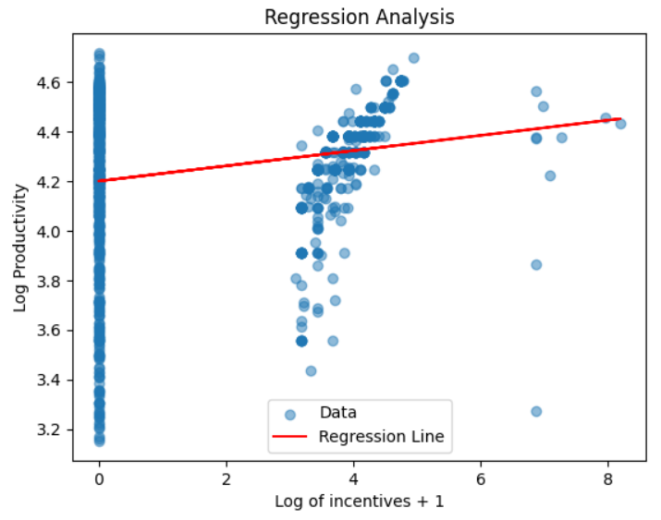
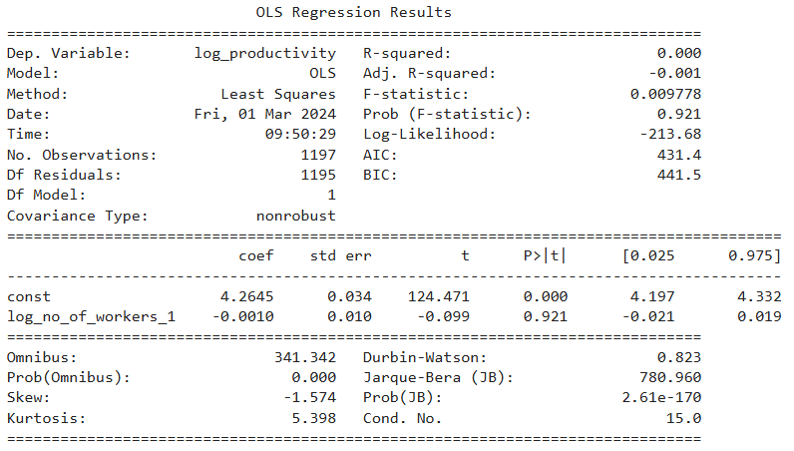
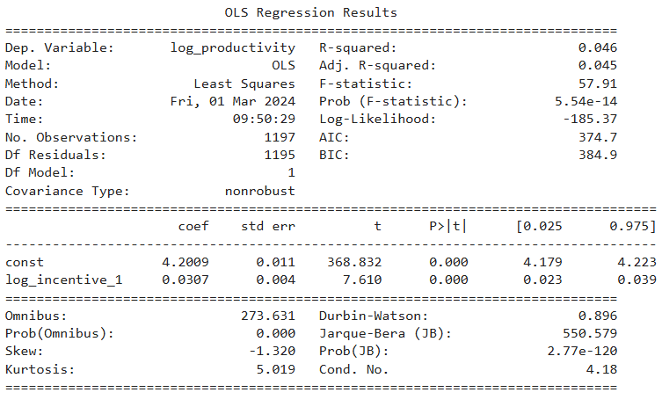
OLS Regression Model for Predicting Productivity Using Number of Workers and Incentive as Predictors
Number of Workers
R-square = 0
Team size does not explain productivity variance
Incentive
R-square= 0.046
Incentives explain 4.6% of the variance in productivity.

Slide 9
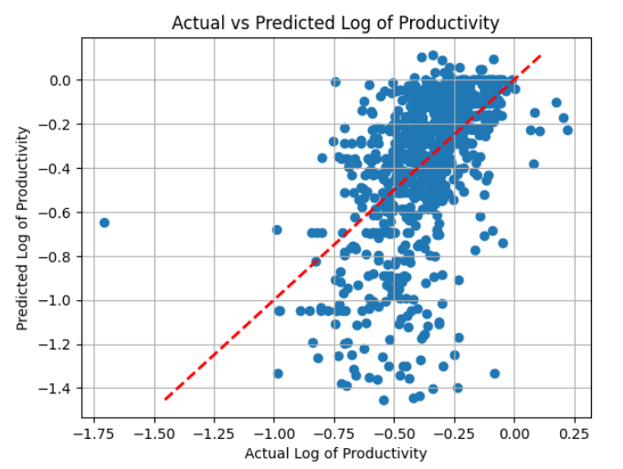
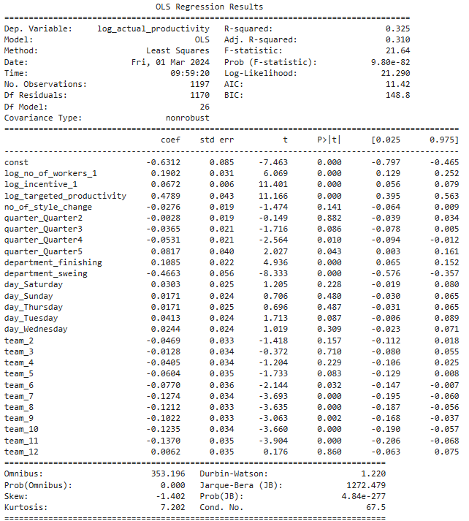
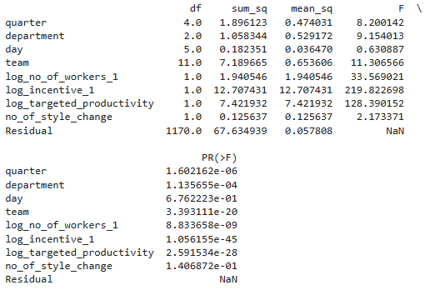
OLS Regression Model for Predicting Productivity
Analyzing the Impact of Number of Workers, Incentive, Targeted Productivity, Style Change, Quarter, Department, and Day on Productivity
R-square= 0.325
The model explains 32.5% of the variance.
Significant contributors (p < 0.05):
Number of Workers
Incentive
Targeted Productivity
Departments (Finishing and Sewing)
ANOVA
Incentive has the highest F-statistic and lowest p-value. Incentive is the key driver of productivity variance.

Slide 10
Result
Optimize Production Planning
Forecast and adjust production plans for different seasons to avoid overproduction or underproduction.
Assess the impact of style changes on productivity and reduce unnecessary changes.
Provide Training to Low Productivity Departments
Improve the Incentive Plan

